Slide 1
DEEP KERNEL LEARNING
Andrew Wilson, Zhiting Hu, Ruslan Salathutnikov, Eric Xing
Jakob Lambert-Hartmann, Niklas Bosch
Notes:
We want to introduce the concept/ proposed model of the paper deep kernel learning

Slide 2
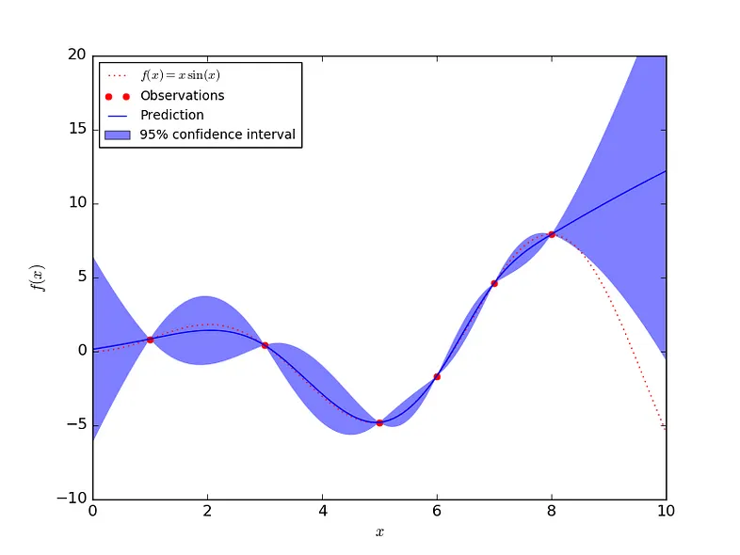
Gaussian Processes
Includes confidence interval into prediction
High confidence near observed data
<number>
[4]

Slide 3
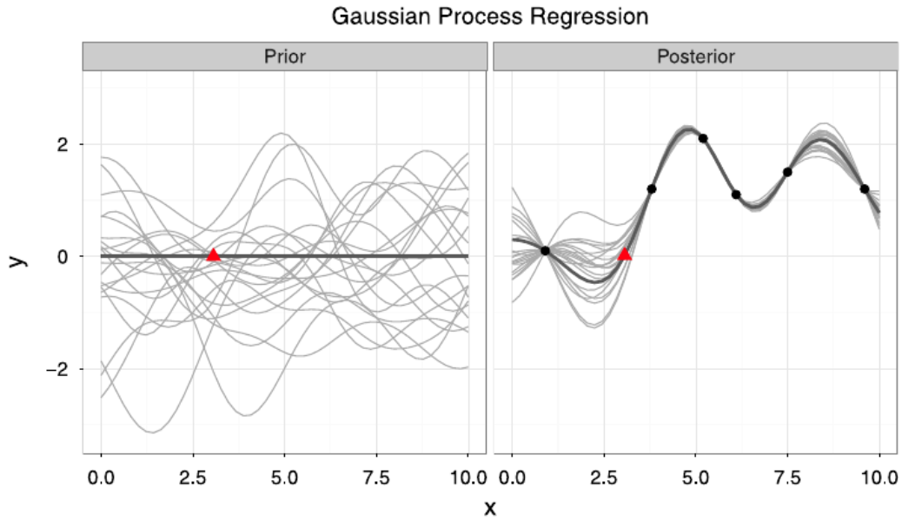
Gaussian Processes
Input:
Distribution of functions (prior)
Observed data
Output:
Infinitly many samples
from prior fitting
observations (posterior)
<number>
[1]

Slide 4
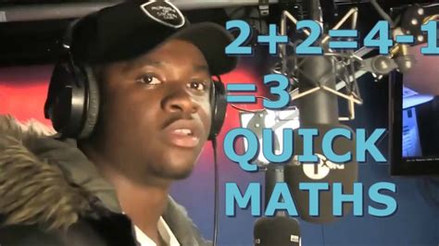
Quick Maths
<number>

Slide 5
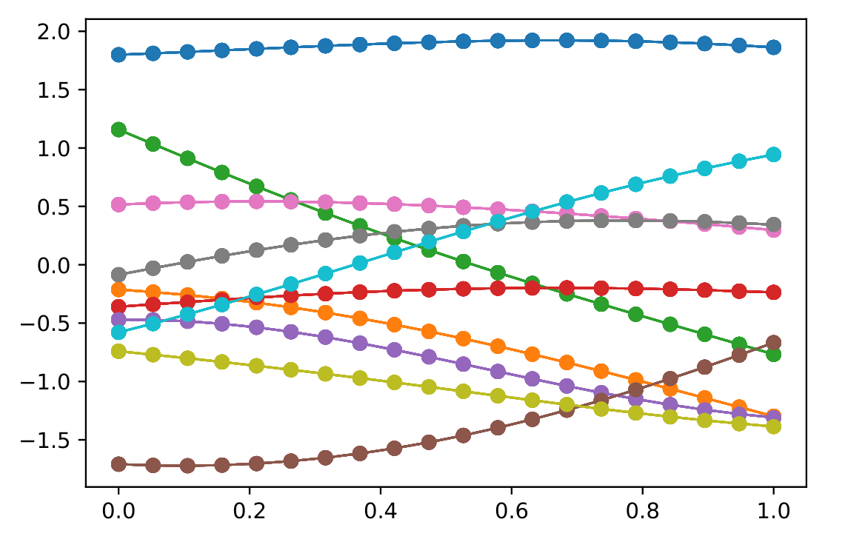
Functions
Sampled points from multivariate
distribution
<number>
[9]

Slide 6
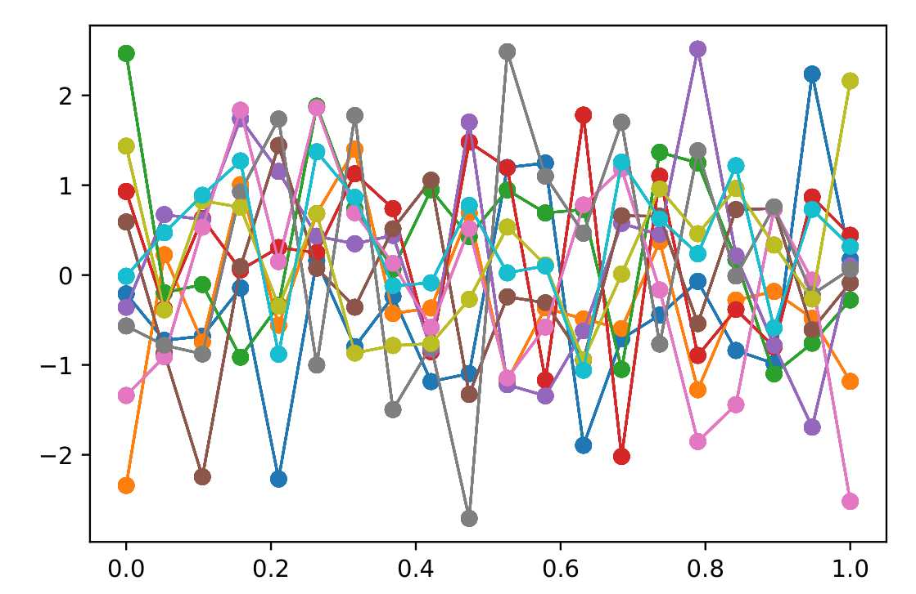
Functions
Not independent because:
similar input → similar output
<number>
[9]

Slide 7
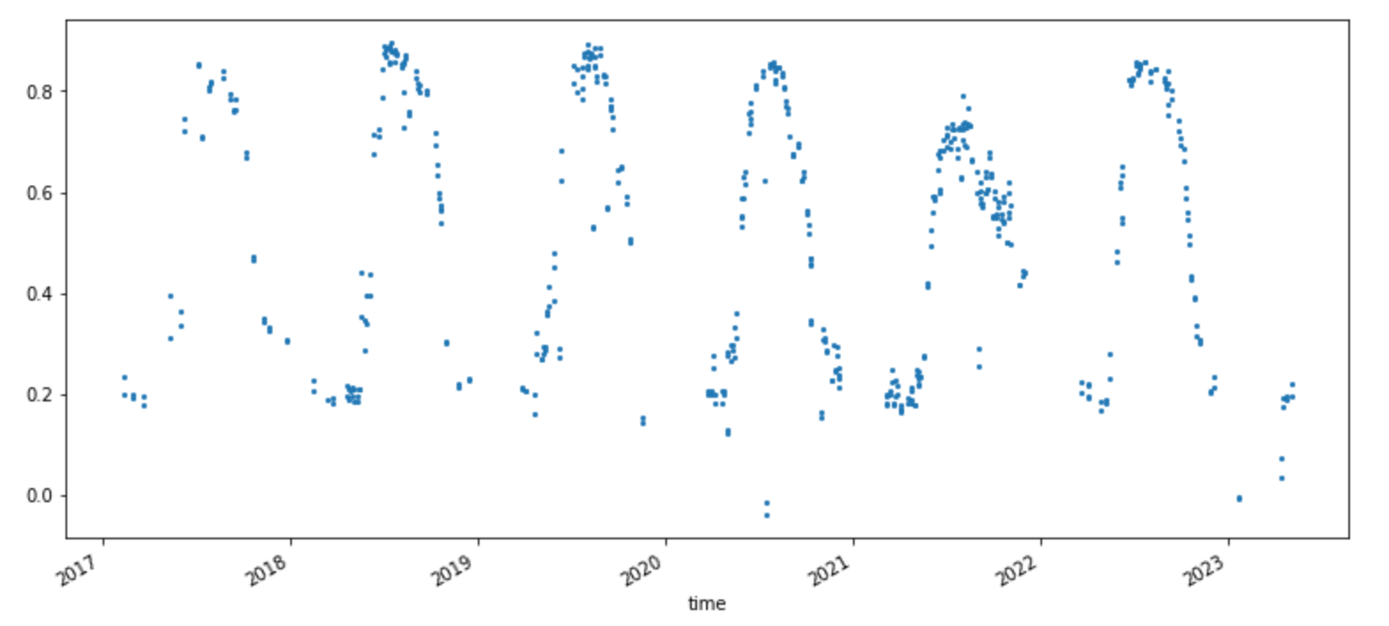
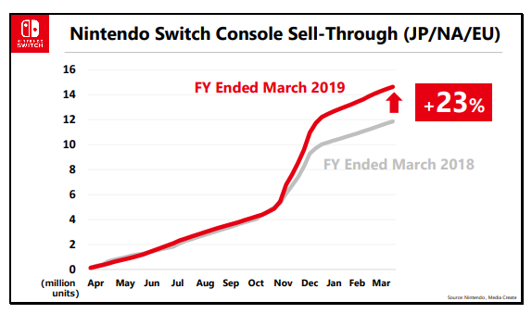
Kernel Functions
Input similarity depends on the context
[2]
Plant activity
[3]
Cumulative sales data
<number>

Slide 8
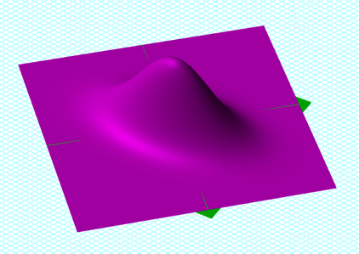
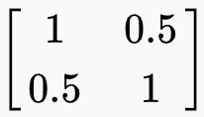

Multivariate distributions
Defined by covariance matrix
<number>
[5]

Slide 9
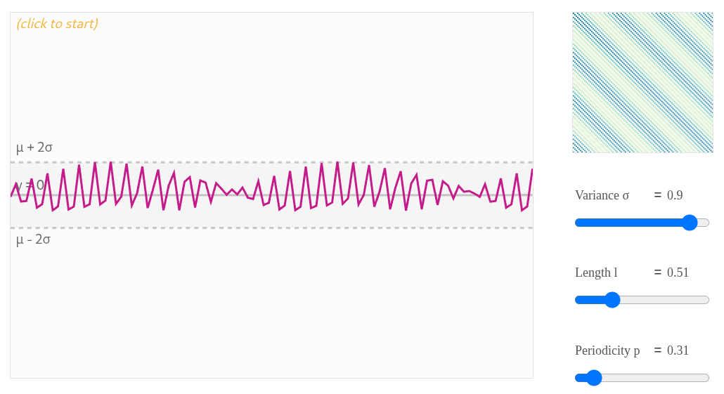
Periodic Kernel
[6]
<number>

Slide 10
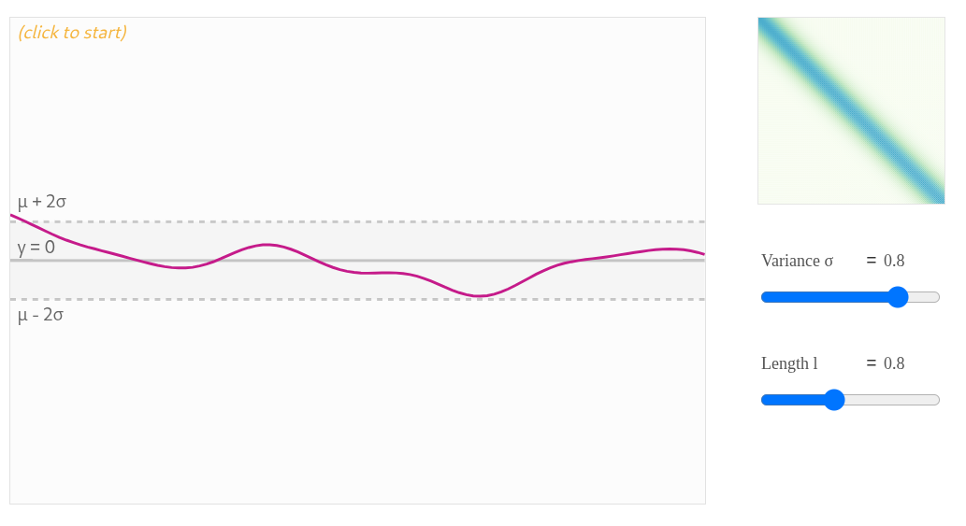
RBF Kernel
[6]
<number>

Slide 11
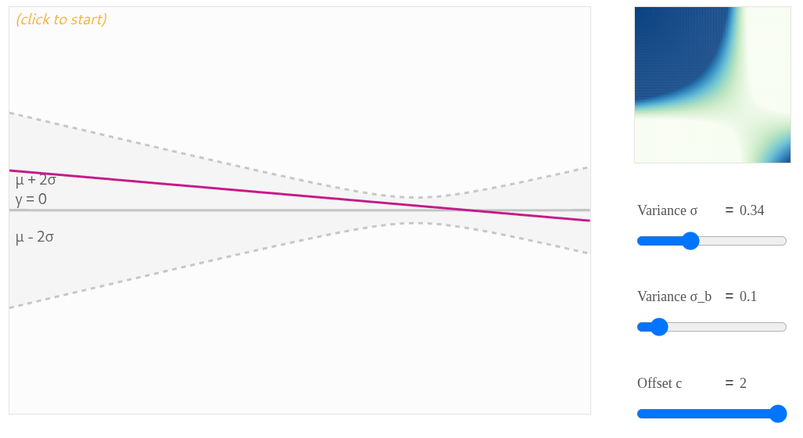
LineaR Kernel
[6]
<number>

Slide 12
Why contrarian to neural networks?
Gaussian Process Regressors:
- models uncertainty
- non parametric
- prior knowledge required
- scale poorly with many data points
Neural Networks:
- predict single value
- millions/billions of parameters
- less prior knowledge
- scale well with many data points
<number>

Slide 13
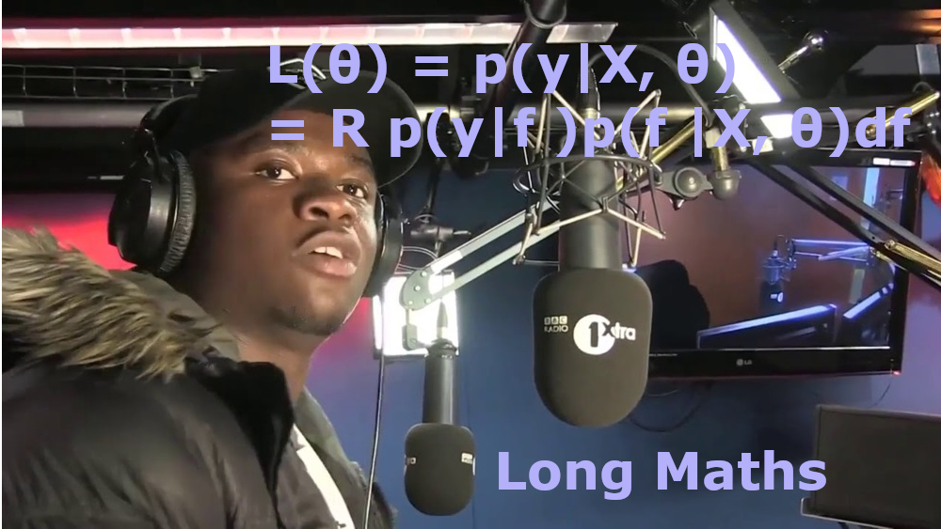
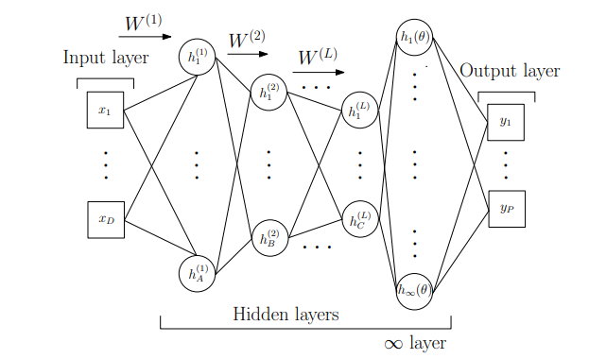


How can we combine these two methods?
Kernel Function:
Kernel Function augmented with DNN:
Notes:
Spectral mixing kernel function:
Mathematical interpretation: augmentation of the kernel function with a transformation
Either simple DNN with ininite wide final layer: nice to include some prior beliefs about the data
Or learnable complex kernel function
Backpropagating a RMSE through an ininite width layer could pose some challenges we need a different approach to training.
Also: we are doing probabilistic machine learning and just comparing the error of one point to a probabilistic distribution wouldnt make much sense

Slide 14

Backpropagation
Log Marginal Likelihood:
To minimize:
Notes:
Determinat of the covariance matrix punishes over complex functions, so we already have some regularization against overfitting
Scaled inverse matrix basically measures the fit of the model to the function we want to approximate
Gradient decent to minimize: we just partially derive in resepect to the hyperparameters

Slide 15

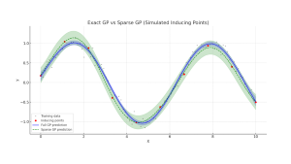
Training
Point inducing method: KISS-GP
approximates the kernel with a subset of data points m
Scales O(n+h(m))
Notes:
Because of some smart assumptions and picking the right points we get a diagonal matrix
H is depending on the choice of kernel functions (parameters and calculations) as well as the neural network (how much does the datapoints get reduced in dimensionality etc.)

Slide 16
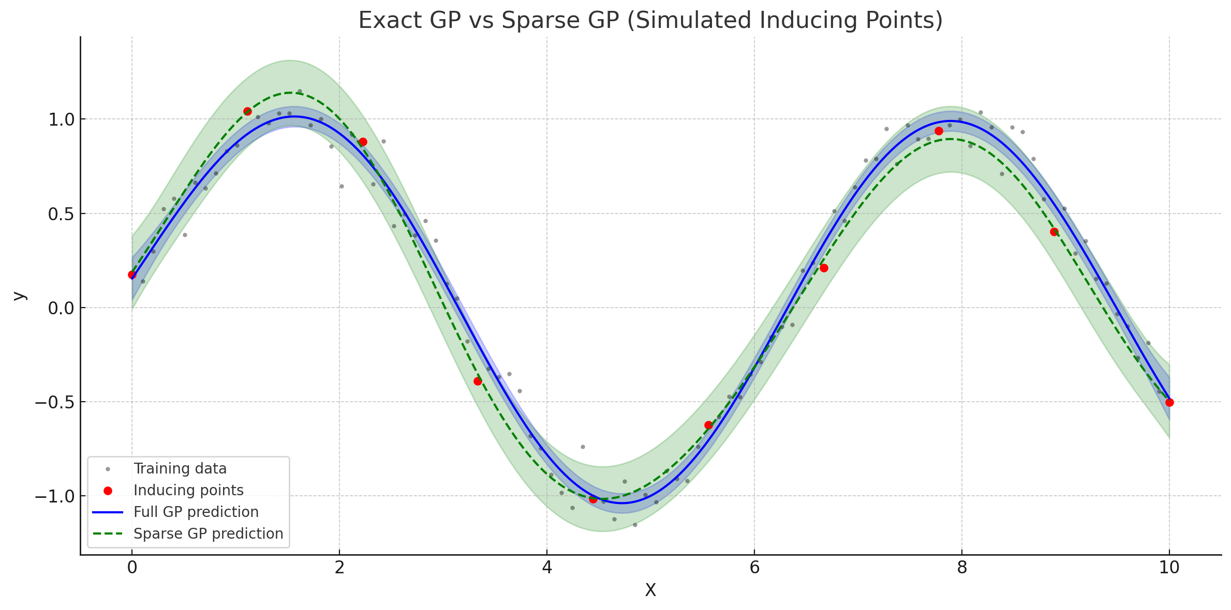

Slide 17
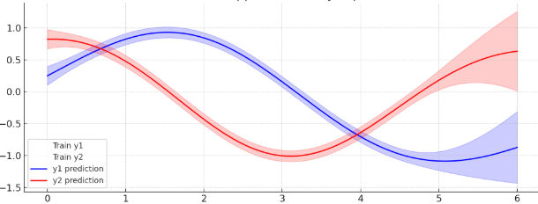
GPR
Single GPR: learns mapping from X to scalar output y
Multitask-GPR
Independent:
Just multiple GPRs
Dependent:
Learns additional dependency structure
Notes:
Dependent: typically some form of matrix that gets combined with the kernel function (intuitive: multiplied with the cov matrix)

Slide 18
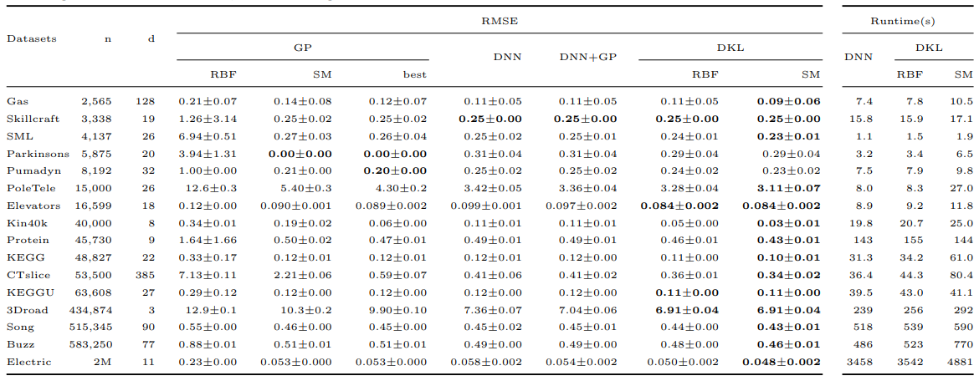
Testing and Findings
Notes:
Great theory and concept, but does it work in practice? :D
Because of KISS-GP Covariance matrix good scaling (typically you would have to invert the matrix …. Better because of?)
Different sizes and complexity
Seen: best results are marked
Runtime optimal with KISS GP almost linear? Depending on the kernel -> more parameters
Generally better: RMSE although seems to be low ist quite a significant change
Really interesting way in probabilistic machine learning to include some prior believes

Slide 19
Sources
1: https://zlthinker.github.io/gaussian-process-regression
2: https://www.streambatch.io/knowledge/ndvi-from-sentinel-2-imagery-using-stac
3: https://gonintendo.com/stories/334105-nintendo-details-switch-sales-pace-compares-to-wii-ds-era-break
4: https://medium.com/analytics-vidhya/interpreting-posterior-of-gaussian-process-for-regression-1bcfaab8e8aa
5: https://en.wikipedia.org/wiki/Covariance_matrix
6: https://distill.pub/2019/visual-exploration-gaussian-processes/
7: https://medium.com/analytics-vidhya/interpreting-posterior-of-gaussian-process-for-regression-1bcfaab8e8aa
8: WILSON, Andrew Gordon, et al. Deep kernel learning. In: Artificial intelligence and statistics. PMLR, 2016. S. 370-378.
9: Wang, Jie. "An intuitive tutorial to Gaussian process regression." Computing in Science & Engineering 25.4 (2023): 4-11.

Slide 20
Thank you for your attention!

